Slide 1
JavaScript: JSON
JavaScript Object Notation

Slide 2
JSON
JavaScript Object Notation
www.json.org
Subset of object-literal notation
All JSON is valid object-literal notation...
...but not all object-literal notation is valid JSON
JSON is a data interchange format, functionally similar to XML

Slide 3
XML like so...
<?xml version="1.0" encoding="UTF-8“ ?> <book id="0375411275"> <author>Ben Rice</author> <title>Pobby and Dingan</title> <copyright>2000</copyright> <publisher>Knopf</publisher> <genre>General Fiction</genre> <isbn>0375411275</isbn> </book>

Slide 4
JSON like so.
{ "book" : { "id" : "66458301", "author" : "Ben Rice", "title" : "Pobby and Dingan", "copyright" : "2000", "publisher" : "Knopf", "genre" : "General Fiction", "isbn" : "66458301" } }

Slide 5
Even Simpler JSON
Can be just a collection of "name" : "value" pairs
{ "givenNames” : "Jonathan", "lastName” : "Swift", "yearOfBirth” : "1667", "yearOfDeath” : "1745" }

Slide 6
Basic JSON Format
curly braces
wrap collections
all text must be
double quoted
{ "book" : { "id" : "66458301", "author" : "Ben Rice", "title" : "Pobby and Dingan", "copyright" : "2000", "publisher" : "Knopf", "genre" : "General Fiction", "isbn" : "66458301" } }
comma after
each entry
no comma before
final curly brace

Slide 7
JavaScript Object Notation
A way to represent JavaScript data
for data interchange
lightweight
human readable (i.e. text-based)
Consists of two data structures:
Collections
A collection of "name" : "value" pairs (an object)
Arrays
a list of values or objects (including arrays)

Slide 8
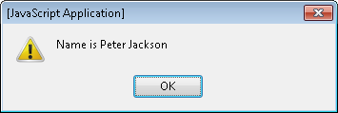
JSON as a Variable
You can assign JSON to a variable in JavaScript var name = {"first":"Peter","last":"Jackson"};
and access its values using dot notation alert("Name is " + name.first + " " name.last);

Slide 9
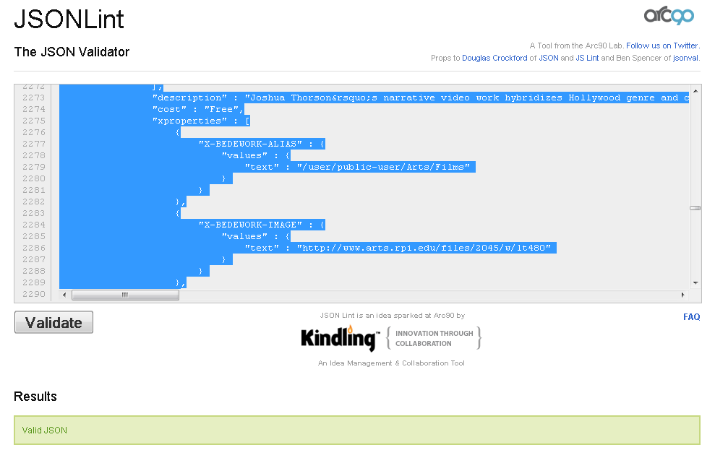
JSON Validation
JSON Lint: http://www.jsonlint.com/

Slide 10
Arrays 1 of 2
Collections of indexed values or objects
A list of primitive values (e.g. [23,12,14,7,39])
A list of objects (e.g. an array of arrays)
Example:
var myArray = new Array("x","y","z"); alert(myArray[0] + " " + myArray[2]); myArray[1] = "some new string value";

Slide 11
Arrays 2 of 2
We can access arrays using square bracket notation:
array[index]
index begins at zero
if(myArray[0] == "x"){ alert("This will execute."); };
W3Schools introduction to arrays: http://www.w3schools.com/JS/js_obj_array.asp

Slide 12
JSON with an Array
{ "books" : [ { "author" : "Ben Rice", "title" : "Pobby and Dingan" }, { "author" : "Stewart O'Nan", "title" : "Last Night at the Lobster" } ] }

Slide 13
Playing with JSON
Download and unzip jsonfun from LMS
Edit jsonfun\json\json.html
Pick out different values from jsonfun\json\example.json to send to the "output" div.
Also, read the W3Schools introduction to Arrays: http://www.w3schools.com/JS/js_obj_array.asp

Slide 14

jQuery has tools to help us process JSON http://learn.jquery.com/

